Slide 1
STROKE DATA ANALYSIS

Slide 2
Stroke continue to attack many….
Specific Objectives:
1. Identify Demographic Trends
Explore and analyze demographic factors such as age, gender, marital status, and residence type to identify any trends or patterns related to strokes.
2. Evaluate Lifestyle Factors
Examine lifestyle factors, specifically smoking status and work type, to understand their association with stroke.
3. Assess Health Metrics Impact
Investigate the impact of health metrics, hypertension, heart disease, average glucose level, and BMI, with respect to stroke.
4. Explore Correlations
Correlation analysis to identify relationships between different health conditions (hypertension, heart disease) and understand their collective influence on strokes.

Slide 3
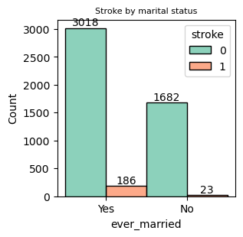
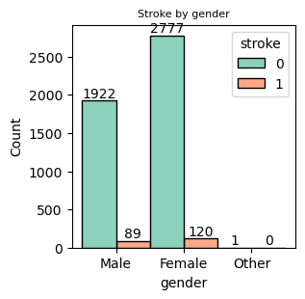
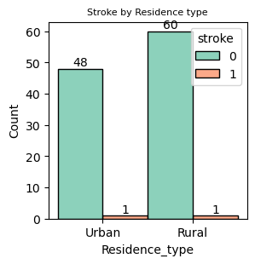
DISTRIBUTION OF STROKE AMONG GENDER, MARITAL STATUS & RESIDENCE TYPE
Many female have stroke compared to male
Stroke is highly significant in married couple
Residence type has no significance in attack by stroke. i.e stroke has the same rate of
attack in either

Slide 4
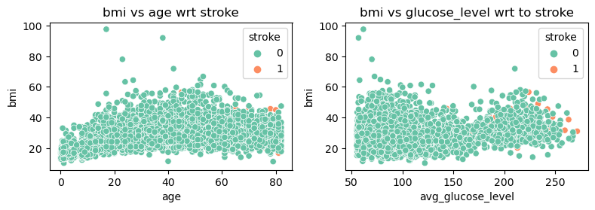
DISTRIBUTION OF STORE WRT AGE & AVG_GLUCOSE_LEVEL
Stroke is much significant as age increases
Stroke is much significant as average glucose level increases

Slide 5
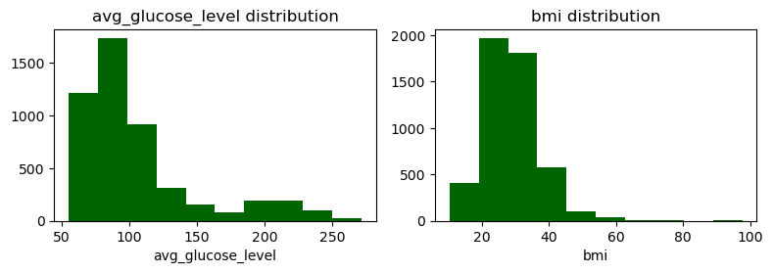
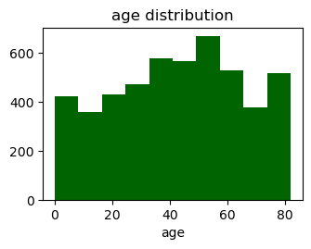
DISTRIBUTION OF STORE ON AGE , BMI & AVG_GLUCOSE_LEVEL
There is right skewness in both bmi and average glucose level this increases outlier presence.
There is a normal distribution of age throughout the population with a peak at 50 years.

Slide 6
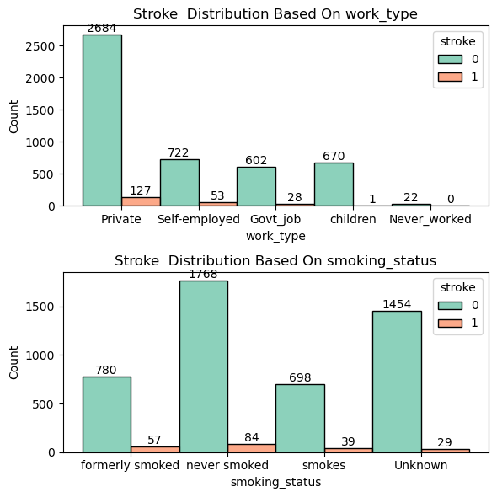
DISTRIBUTION OF STROKE WRT WORK_TYPE & SMOKING STATUS
Stroke is much significant among those working in private sectors
Stroke is much significant among those who never smoked, formerly smoked, smokes and those whose smoking status is unknown.

Slide 7
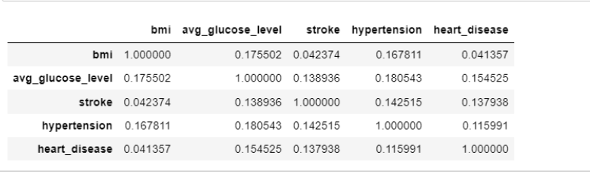
CORRELATION BETWEEN STROKE, HYPERTENSION & HEART DISEASE
Stroke is much significant among those with heart disease, hypertension and average glucose level but not so significant given a person’s Bmi
Stroke is much significant among those with heart disease and hypertension

Slide 8
FINDINGS
Demographic and other risk factors .
Prevalence: -Stroke is more significant in female that in male etc.
Geographical variations-we examined the stroke rates across different residential type and we concluded that geography was not significant. Either in urban or rural stroke rates remains the same.
Trends:
Stroke was significant in married couple
Stroke was significant in those working in private sectors
Bmi and glucose level are a causation of stroke
Average BMI Disparity in Marital Status: Despite considering residence types, the analysis reveals that married individuals exhibit a higher average BMI compared to their unmarried counterparts.
Glucose Levels and Smoking Habits: Individuals who smoke demonstrate lower glucose levels in comparison to non-smokers or those who have quit smoking.
Association between Glucose Levels, Hypertension, and Employment History: Average glucose levels are found to be higher among individuals without hypertension and comparatively lower among those who have never worked.

Slide 9
RECOMMENDATIONS
1. Develop appropriate interventions tailored to address risk factors prevalent in certain demographics.
2. In lifestyle factors we can launch community programs promoting healthy lifestyles
3. Average BMI for married individuals. Explore the factors contributing to the higher average BMI among married individuals.
Could it be lifestyle choices, dietary habits, or other socio-economic factors?
Carry out a survey to gather qualitative data on lifestyle choices among married and unmarried individuals.
4. Glucose Levels for Smokers:
Investigate the reasons behind the lower glucose levels among smokers compared to non-smokers or those who quit smoking.
Assess whether this is due to lifestyle factors or if there are other underlying reasons.
Explore the impact of stopping smoking on glucose levels.
Carry out a survey or research to identify potential health risks associated with lower glucose levels in smokers.
5. Average Glucose Levels and Hypertension versus Employment Status:
Further investigate the relationship between average glucose levels, hypertension, and employment status to check whether there are specific occupational factors contributing to glucose levels.
Explore how employment status impacts on lifestyle choices which finally may have an influence glucose level.
6. Carry out a research on an equal sample size to investigate the prevalence of stroke among the sectors.

Slide 10
Thank you

